Slide 1

DCC Spring Training Days 2025
Van Ruwe Data tot Publiekatiepakket
deel 1: Organiseren en opschonen van data
deel 2: Publikatiepakket
Marta Kargól, Saxion
Renate Mattiszik, Saxion
Willemijn Plomp, Universiteit Leiden
15 April 2025
Bron: Mattiszik, R., Vermaas, M., & van de Sandt, S. (2024). Organizing your data and software with a reproducible project workflow - 2024 DCC Spring Training Materials (Versie 2024). Zenodo. https://doi.org/10.5281/zenodo.11061154

Slide 2

Programma:
09.30 – 09.50 Opening en kennismaking
09.50 – 11.05 Organiseren en opschonen van data
11.05 – 11.15 Pauze
11.15 – 12.30 Publikatiepakket

Slide 3
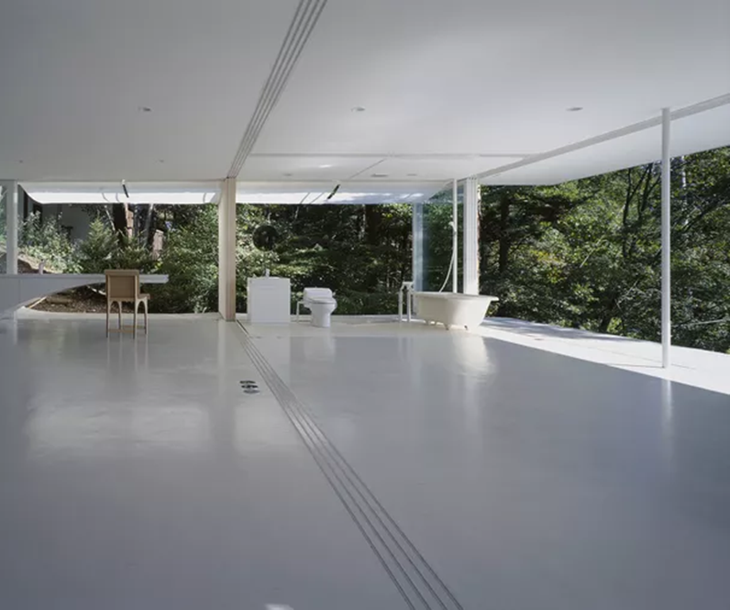
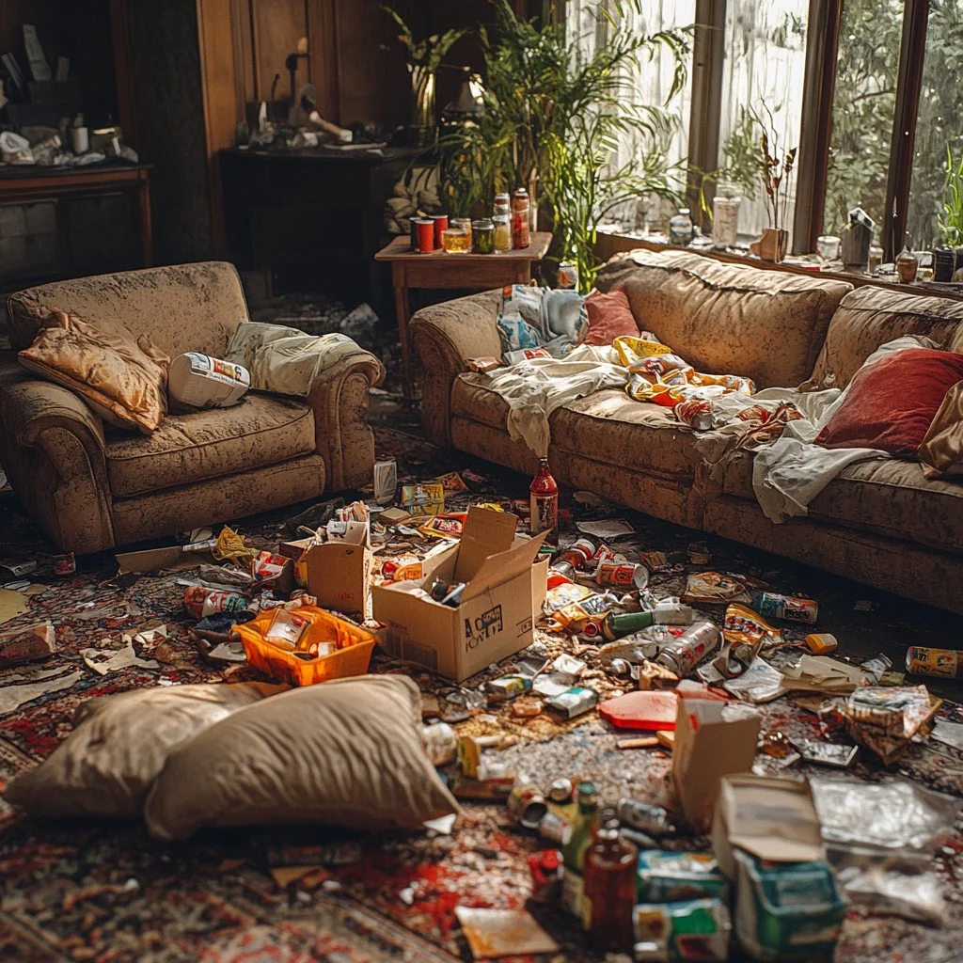
Hoe ziet jouw woonkamer er uit?
Forgemind ArchiMedia / CC BY 2.0 / Flickr
Photo by https://stockcake.com/i/cluttered-living-room_1232108_1042091

Slide 4
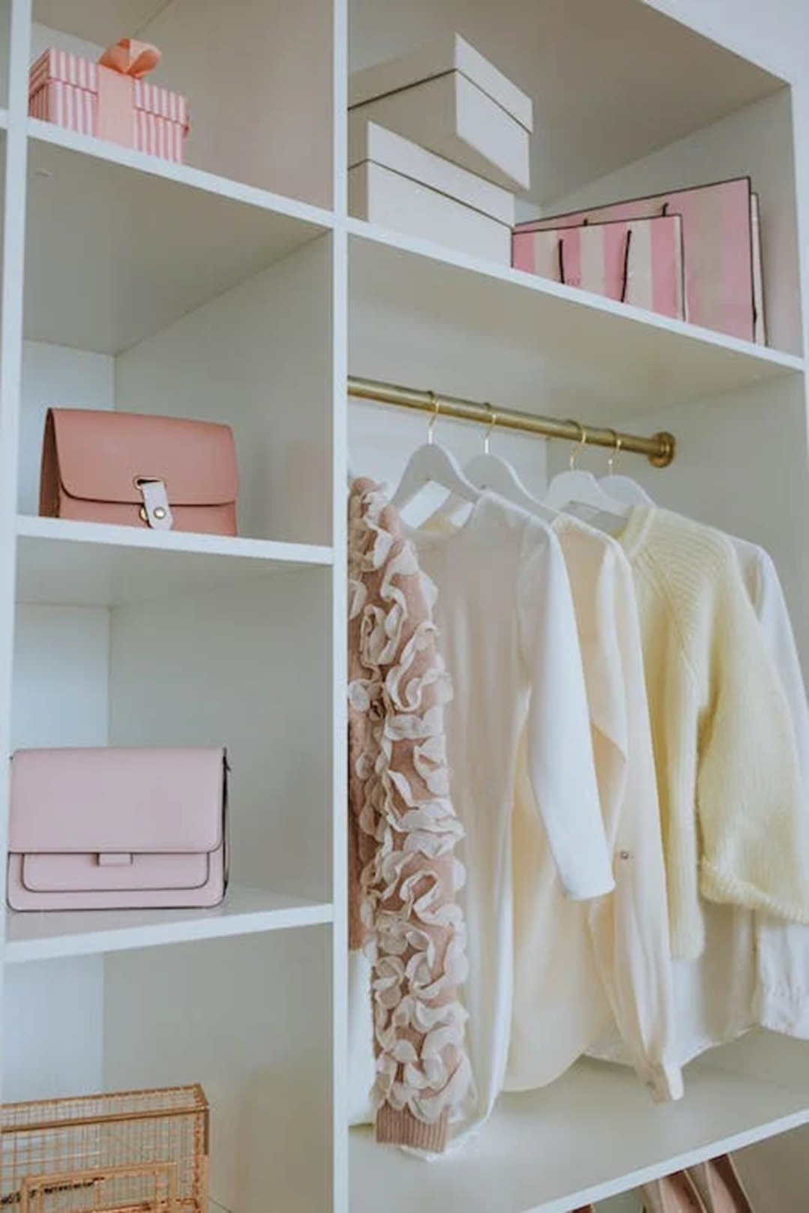
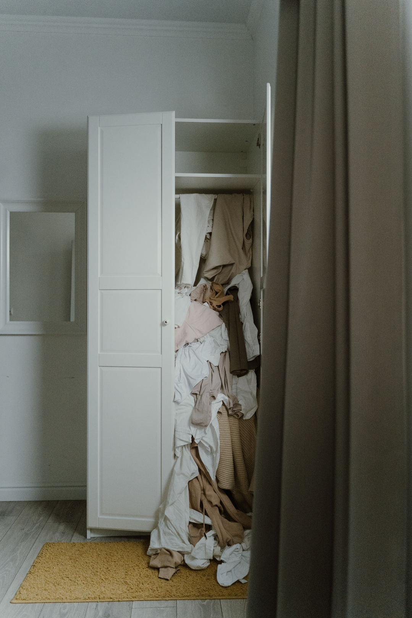
Hoe is je bureaublad georganiseerd?
Anastasia Shuraeva: A White Wooden Closet of a Woman.
Pexels
Ron Lach: Photo of an Untidy and Messy White Wooden Closet. Pexels

Slide 5


Hoeveel bestanden heb je?
Photo by https://stockcake.com/i/floating-lego-bricks_2115305_1238333
Photo by https://stockcake.com/i/colorful-lego-cascade_1550260_1181876

Slide 6


Weet je waar de data van je eerste project zich nu bevinden?
Photo by https://stockcake.com/i/digital-search-lens_2127356_1304524
Photo by https://stockcake.com/i/digital-file-cascade_2077835_1246281

Slide 7
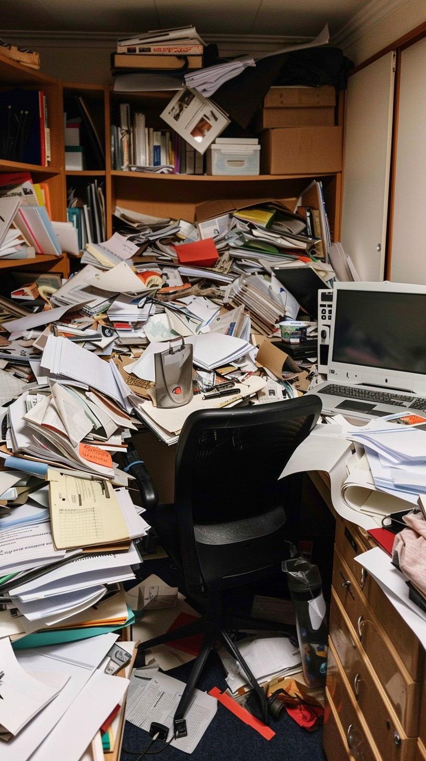

Deel 1: Organiseren en opschonen van data
Photo by https://stockcake.com/i/cluttered-office-space_903056_684481
Photo by https://stockcake.com/i/stylish-home-office_234080_44570
Notes:
Organiseren van data:
Wanneer ga je beginnen?
Folder structure
Naam conventies
Relation metadata
AVG opnemen
Publication package folder opnemen
Opschonen van data
Data zelf opschonen maar ook datasets (version control)
Readme file

Slide 8
Details van de data
 | Soort (sensor metingen, interviewopnames, transcripten, survey output, literatuur onderzoek etc.) | Bestands-formaten | Volume (GBs)
Raw data
Cleaned data
Final data

Slide 9
1. Bewaar je project in één map

Slide 10

Mijn_project
README
data
tools
manuscript
Notes:
Start with your project in a single folder. Everything that relates to your project will be inside this folder. This will make your project portable and cohesive; it will make it easy for someone else to make sense of it. This is a habit that applies with projects anywhere, but particularly in research projects it contributes to their reproducibility, which is of course a vital component of good science.

Slide 11
2. Bedenk een logisch systeem van submappen

Slide 12


README.md
LICENTIE
data/
raw/ RAW_DATA_FILE001.zip
(…)
RAW_DATA_FILE331.zip
clean/
mijndata.csv
R/
mijncode.R
resultaten/
images/
figure1.tiff
figure2.tiff
analyse/
tabel1.csv
docs/
publikatiepakket.md
manuscript.md
README.md
LICENTIE
data/
mijndata.csv
analyse/
rapport.md
Notes:
Make a logical system of sub folders, looking at what is standard in the field. There is no one-size-fits-all, but this can be a good structure for a research project. Having folders separate for data for documentation and for figures. Make sure you structure your sub folders in a logical way.
Don’t be afraid to make sub sub and sub sub sub folders, so long as it is logical.

Slide 13
README.md
LICENTIE
data/
raw/ RAW_DATA_FILE001.zip
(…)
RAW_DATA_FILE331.zip
clean/
mijndata.csv
R/
mijncode.R
resultaten
images/
figure1.tiff
figure2.tiff
analyse/
tabel1.csv
docs/
publikatiepakket.md
manuscript.md
README.md
LICENTIE
data/
mijndata.csv
analyse/
rapport.md
Notes:
Make a logical system of sub folders, looking at what is standard in the field. There is no one-size-fits-all, but this can be a good structure for a research project. Having folders separate for data for documentation and for figures. Make sure you structure your sub folders in a logical way.
Don’t be afraid to make sub sub and sub sub sub folders, so long as it is logical.

Slide 14
3. Introduceer het project in een README

Slide 15
Documentatie via README
Wie zijn erbij betrokken?
Waar gaat het project over?
Hoe worden de data verzameld?
Wanneer en waar wordt het onderzoek uitgevoerd?
Ook mogelijk:
Afkortingen
Mappenstructuur
Bestandsnaamconversies
Referenties & links
Zie ook https://dcc-po.nl/publicaties/handleiding-datadocumentatie/
Notes:
Especially on higher levels, it’s recommended that each folder contains a description, or a README file, that describes the content of that folder. There are certain things you can put in that README file. A good thing to start with is always to ask yourself: what if, in one year time, you see this folder again, what information do you need to understand it fully? With almost everything we are going to show you, you yourself are the most likely the one to benefit from a good project structure, and good documentation. Keep this in mind.
Other content you can put in a README, aside from a general overview of the project, is: an explanation of any abbreviations used, the expected files and folders in your project and their purpose, names of contributors and their roles, and any links or references to important sources.

Slide 16
4. Gebruik interoperabele bestandsformaten

Slide 17
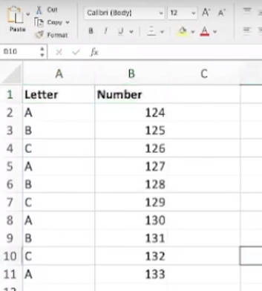
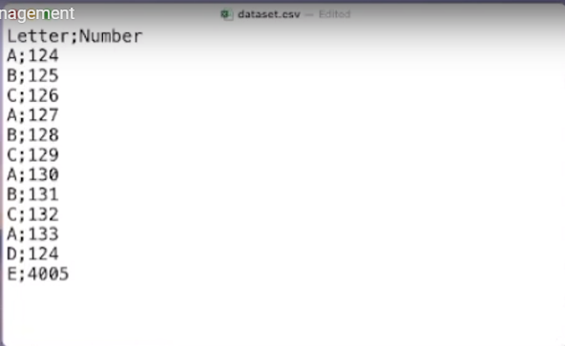
Notes:
Using Excel may be great for you now, with all its bells and whistles, but what if you leave your position and are no longer able to pay for the software. Can you still access your own data? What if someone who wants to reuse your project does not have access to Excel? And what happens to the file in 10 years? Would you feel confident that you can access and successfully read an Excel file from 10 years ago?
Instead, we recommend that you save data in a format that will work with Excel, but is not dependent on the software to be read. This format, .csv, takes the form of a table where items in different columns are separated by commas (or other characters). The data is stored in plain text, which allows it to be read by many different types of software, including a plain text editor. And, importantly, a .csv file will likely outlive you.
For almost any proprietary file type there is an interoperable alternative. Instead of a word document, save your text as a txt file, or perhaps formatted using Markdown. Information is ideally stored as plain text, but an interoperable file format can be different. The important thing is that it can be used by diverse platforms and applications, and does not require paid software to be accessible.

Slide 18
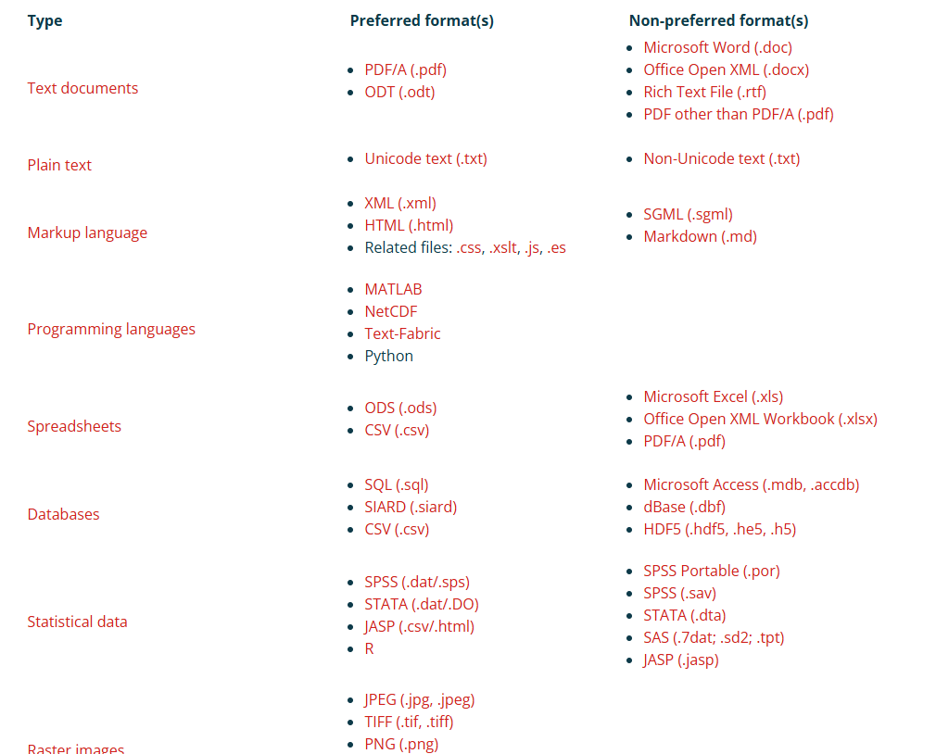
Voorkeursformaten

Slide 19
5. Gebruik beschrijvende en logische bestandsnamen

Slide 20
Maak bestandsnamen:
Machine readable
Leesbaar voor mensen
Logisch sorteerbaar
Credit: Jenny Bryan
Notes:
File names themselves can be important documentation. We are long past the time that file names need to be short, although there is obviously a limit. A file name first of all is a description of the file that is tightly connected to that file. Filenames can be used to find the right data quickly amidst a jumble of files, or they can be used to identify the content of a stray file.
Naming a file right is therefore important

Slide 21
Vermijd spaties, accenten, vreemde leestekens...
Gebruik scheidingstekens (koppeltekens, onderstrepingstekens) om elementen eenvoudig van elkaar te scheiden
Maak bestandsnamen:
Machine readable
Leesbaar voor mensen
Logisch sorteerbaar
Gebruik informatieve elementen zodat bestanden makkelijk gevonden kunnen worden
Credit: Jenny Bryan
Notes:
There are three main considerations to make. File names should first of all be machine readable. This means using a latin alphabet, with consistent capitalization, and no spaces or strange characters. When a filename contains important information about the content of that file, it can be used to quickly retrieve that file inside your system.

Slide 22
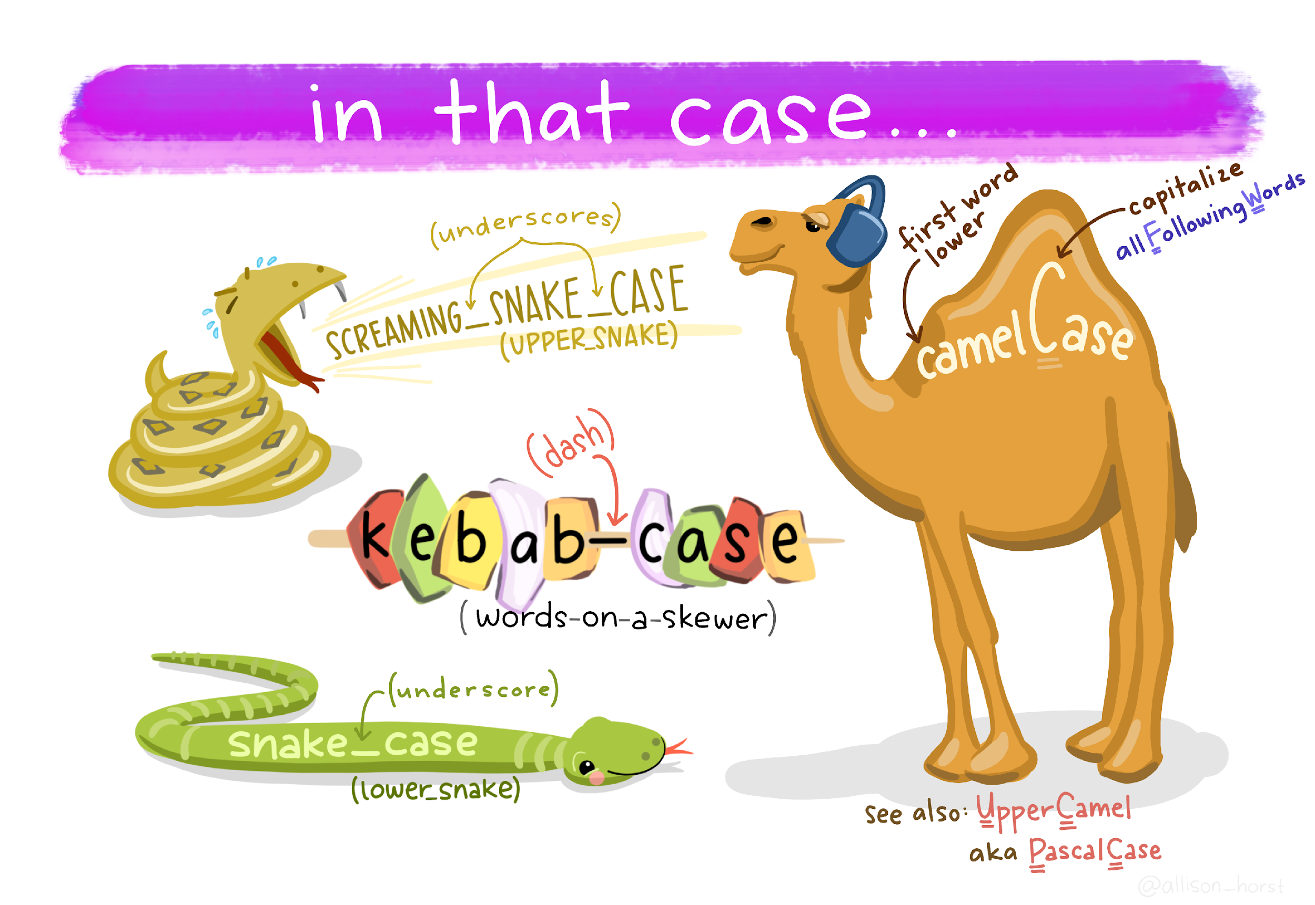
Credit: Allison Horst
Notes:
A filename does not need to be short, but words should never be separated by spaces. Instead use underscores (snake case), hyphens (kebab case), or consistent capitalization (camel case) to separate elements. Using hyphens or underscores has the added advantage that it is easy to separate elements automatically based on the patterns found in a name.

Slide 23
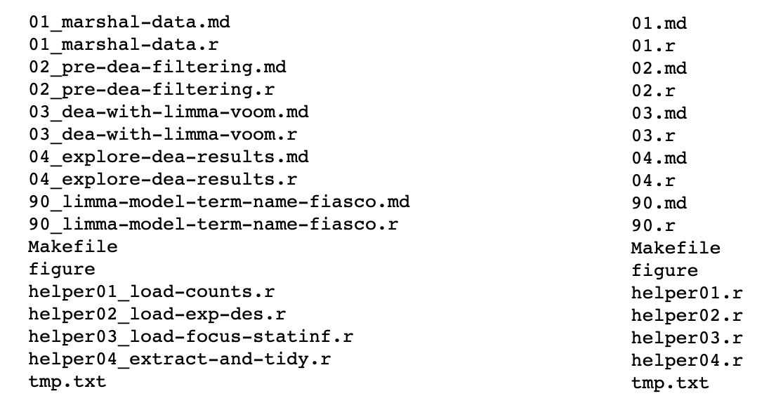
Welke set bestands(namen) begrijp je om 3 uur 's ochtends vóór een deadline?
Maak bestandsnamen:
Machine readable
Leesbaar voor mensen
Logisch sorteerbaar
informatieve elementen
Credit: Jenny Bryan
Notes:
Most importantly though, file names should be intelligible for humans. That means that they should contain information that identifies the content of that file for you, or ideally another person. Jenny Bryan, who gave an excellent lecture about this, gave this example to drive that point home: what filenames would you rather see at 3AM before a deadline?

Slide 24
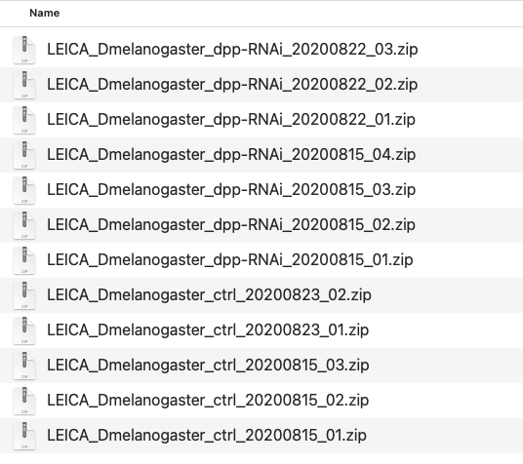
File naming
Maak bestandsnamen:
Machine readable
Leesbaar voor mensen
Logisch sorteerbaar
Notes:
Finally, file names will be important when you want to sort your files. Therefore, make sure that file names start with the most general descriptor of the file content. For example, when you are including a date in your file (and you probably should) start with the year, then the month, and then the day. This will make sure that when you are sorting your files, you will sort them chronologically, and not all the October files with other October files, for example. It also prevents any confusion with date notation in different parts of the world.

Slide 25
6. Schoon data op

Slide 26


Slide 27
Een voorbeeld van untidy data: weermetingen
Sensor_id | Temp day 1 | Sun day 1 | Temp day 2 | Sun day 2
NY_01 | 26 | 189 | 25 | 594
Amst_01 | 12 | 2,8 | 16 | 0,7
NY_02 | 30 | 254 | 15 | 5

Slide 28
Een voorbeeld van untidy data: weermetingen
Sensor_id | Temp day 1 | Sun day 1 | Temp day 2 | Sun day 2
NY_01 | 26 | 189 | 25 | 594
Amst_01 | 12 | 2,8 | 16 | 0,7
NY_02 | 30 | 254 | 15 | 5

Slide 29
Een voorbeeld van untidy data: weermetingen
Waarden in kolomnaam
Sensor_id | Temp day 1 | Sun day 1 | Temp day 2 | Sun day 2
NY_01 | 26 | 189 | 25 | 594
Amst_01 | 12 | 2,8 | 16 | 0,7
NY_02 | 30 | 254 | 15 | 5

Slide 30
Een voorbeeld van untidy data: weermetingen
Meerdere observaties in één rij
Sensor_id | Temp day 1 | Sun day 1 | Temp day 2 | Sun day 2
NY_01 | 26 | 189 | 25 | 594
Amst_01 | 12 | 2,8 | 16 | 0,7
NY_02 | 30 | 254 | 15 | 5

Slide 31
Readme:
Temp = Celsius
Sun = minutes of sunshine/day
Sensor_id | Element | Day | Measurements
Amst_01 | Temp | 1 | 12
Amst_01 | Sun | 1 | 168
Amst_01 | Temp | 2 | 16
Amst_01 | Sun | 2 | 42
NY_01 | Temp | 1 | -3
NY_01 | Sun | 1 | 189
NY_01 | Temp | 2 | -4
NY_01 | Sun | 2 | 594
NY_02 | Temp | 1 | -1
NY_02 | Sun | 1 | 254
NY_02 | Temp | 2 | 15
NY_02 | Sun | 2 | 300

Slide 32
De zelfde data maar dan tidy
Readme:
Temp = Celsius
Sun = minutes of sunshine/day
sensor_id | Day | Temp | Sun
Amst_01 | 1 | 12 | 168
Amst_01 | 2 | 16 | 42
NY_01 | 1 | -3 | 189
NY_01 | 2 | -4 | 594
NY_02 | 1 | -1 | 254
NY_02 | 2 | 15 | 300

Slide 33
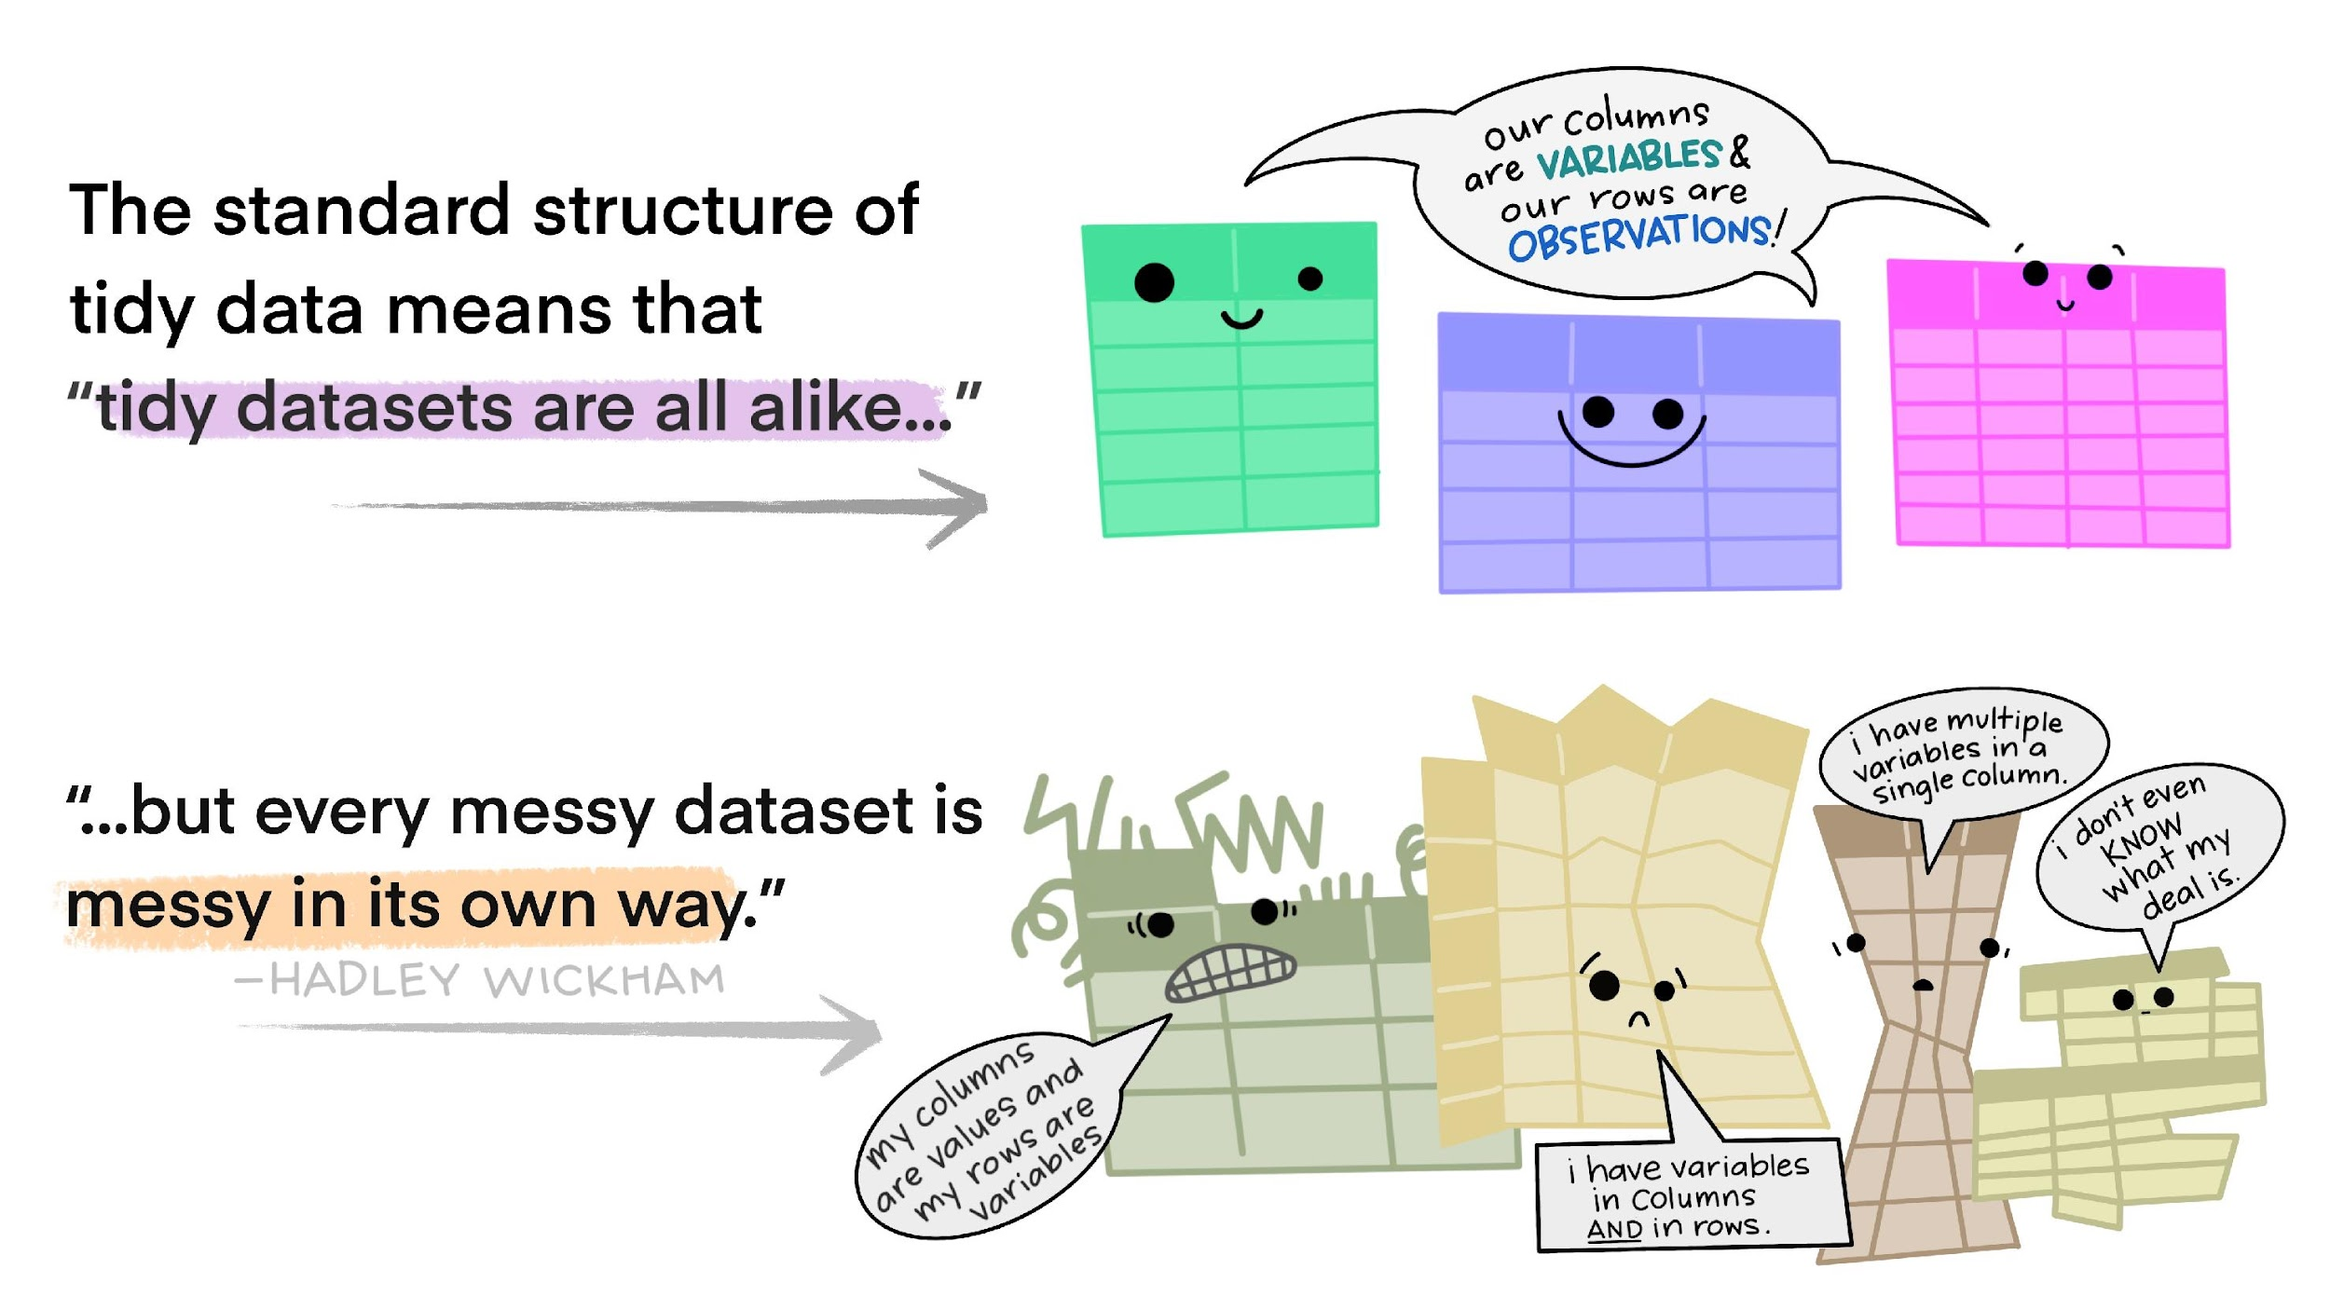
Visualization credit: Illustrations from the Openscapes blog Tidy Data for reproducibility, efficiency, and collaboration by Julia Lowndes and Allison Horst
Notes:
The tidy format standardizes the structure of the data, making it more straightforward to interpret and to run analyses on.

Slide 34
1. Bewaar je project in één map
2. Bedenk een logisch systeem van submappen
3. Introduceer het project in een README
4. Gebruik interoperabele bestandsformaten
5. Gebruik beschrijvende en logische bestandsnamen
6. Schoon data op

Slide 35

Opdracht data opschonen
Photo by https://stockcake.com/i/team-analyzing-documents_1223301_702038
Notes:
That same data can be put in a tidy format. No data is lost, though it looks different.
Link naar git hub
Wood duck data
uitpakken,
opschonen,
naamgeving,
mappenstructuur
Voorkeursformaten?
Readme file

Slide 36
Opdracht
Individual ID | Mass | Average Ambient Temperature | Average Incubation Temperature | Incubation Period (days) | number of eggs | number of eggs hatched | Nest initiation day of year
H3 | 545 | 18.31 | 34.73 | 29.63 | 9 | 7 | 82
A1B | 645 | 22.46 | 32.09 | 32.04 | Probably 14 | 11 | 100
N4 | 605 | 14.44 | 31.96 | 32.42 | 17 | 14 | 57
N8 | 590 | 20.13 | 35.6 |  | 4 | 4 | 86
O2 | 540 | 19.74 | 31.34 | 33.71 | 13 | 10 | 86
U10C | 0.55 | 22.80 | 34.27 | 31.92 | 9 | 6 | 94
O3A | 560 | 13.04 | 33.56 | no | 5? | 4 | 55
O3B | 0.56 | 24.58 | 33.52 | 30.04 | 13 | 11 | 117
T2B | 0.57 | 25.28 | 35.97 | 29.54 | 7 | 6 | 119
T6A | 0.53 | 13.90 | 34.48 | 30.13 | 7 | 3 | unknown
T9 | 0.57 | 19.23 | 31.94 | none | 14 | 11 | 71
Notes:
That same data can be put in a tidy format. No data is lost, though it looks different.

Slide 37
Opdracht
Individual ID | Mass | Average Ambient Temperature | Average Incubation Temperature | Incubation Period (days) | number of eggs | number of eggs hatched | Nest initiation day of year
A1B | 645 | 22.46 | 32.09 | 32.04 | Probably 14 | 11 | 100
H3 | 545 | 18.31 | 34.73 | 29.63 | 9 | 7 | 82
N4 | 605 | 14.44 | 31.96 | 32.42 | 17 | 14 | 57
N8 | 590 | 20.13 | 35.6 |  | 4 | 4 | 86
O2 | 540 | 19.74 | 31.34 | 33.71 | 13 | 10 | 86
O3A | 560 | 13.04 | 33.56 | no | 5? | 4 | 55
O3B | 0.56 | 24.58 | 33.52 | 30.04 | 13 | 11 | 117
T2B | 0.57 | 25.28 | 35.97 | 29.54 | 7 | 6 | 119
T6A | 0.53 | 13.90 | 34.48 | 30.13 | 7 | 3 | unknown
T9 | 0.57 | 19.23 | 31.94 | none | 14 | 11 | 71
U10C | 0.55 | 22.80 | 34.27 | 31.92 | 9 | 6 | 94
Notes:
That same data can be put in a tidy format. No data is lost, though it looks different.

Slide 38

Welke vragen hebben jullie?

Slide 39
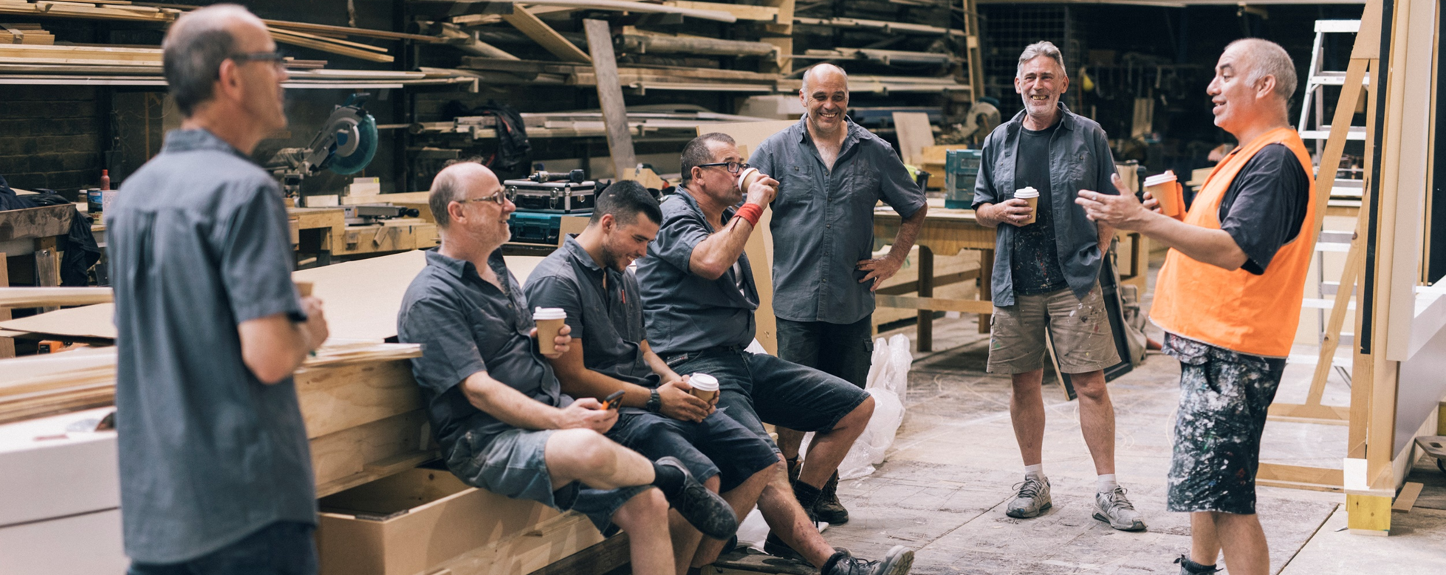
Pauze
Notes:
That same data can be put in a tidy format. No data is lost, though it looks different.

Slide 40
Deel 2: Publikatiepakket
Notes:
That same data can be put in a tidy format. No data is lost, though it looks different.

